Slide 1

Milling machines

Slide 2
CONTENTS
Milling
Milling Machines
Milling Operations
Specifications of Milling Machine
Grinding
Abrasives & Bonding Materials
Grinding Machines

Slide 3
MILLING
Milling: is a metal cutting operation in which the excess material from the work piece is removed by rotating multipoint cutting tool called milling cutter.
Milling machine: is a power operated machine tool in which work piece mounted on a moving table is machined to various shapes when moved under a slow revolving serrated cutter.

Slide 4
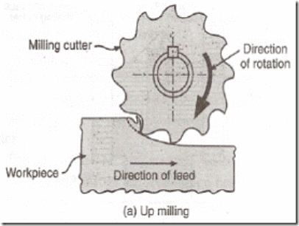
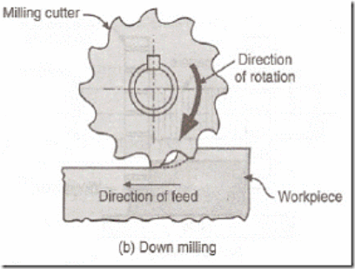
PRINCIPLE OF MILLING

Slide 5
COMPARISON BETWEEN UP MILLING & DOWN MILLING
SL. NO. | UP MILLING (CONVENTIONAL MILLING) | DOWN MILLING (CLIMB MILLING)
01 | Work piece fed in the opposite direction that of the cutter. | Work piece fed in the same direction that of the cutter.
02 | Chips are progressively thicker. | Chips are progressively thinner.
03 | Strong clamping is required since the cutting force is directed upwards & tends to lift the work piece. | Strong clamping is not required since the cutting force is directed downwards & keep the work piece pressed to the table.
04 | Gives poor surface finish, since chips gets accumulated at the cutting zone. | Gives good surface finish, since the chips are thrown away during cutting.
05 | Used for hard materials. | Used for soft materials and finishing operations.

Slide 6
CLASSIFICATION OF MILLING MACHINES
1. Column and knee milling machines
a. Plain column & knee type milling machine
- Horizontal spindle type
- Vertical spindle type
2. Bed type milling machine
3. Planer type milling machine
4. Special purpose milling machine
a. Tracer controlled milling machine
b. Thread milling machine
c. CNC milling machine

Slide 7
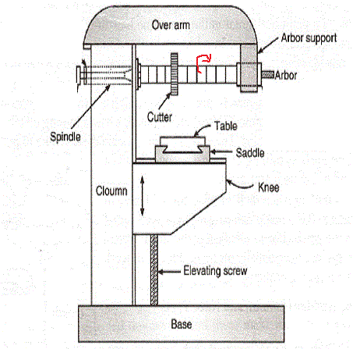
HORIZONTAL MILLING MACHINE
MAJOR PARTS :
BASE
COLUMN
SPINDLE
OVERARM
KNEE
SADDLE
WORKTABLE
FIG. HORIZONTAL MILLING MACHINE

Slide 9
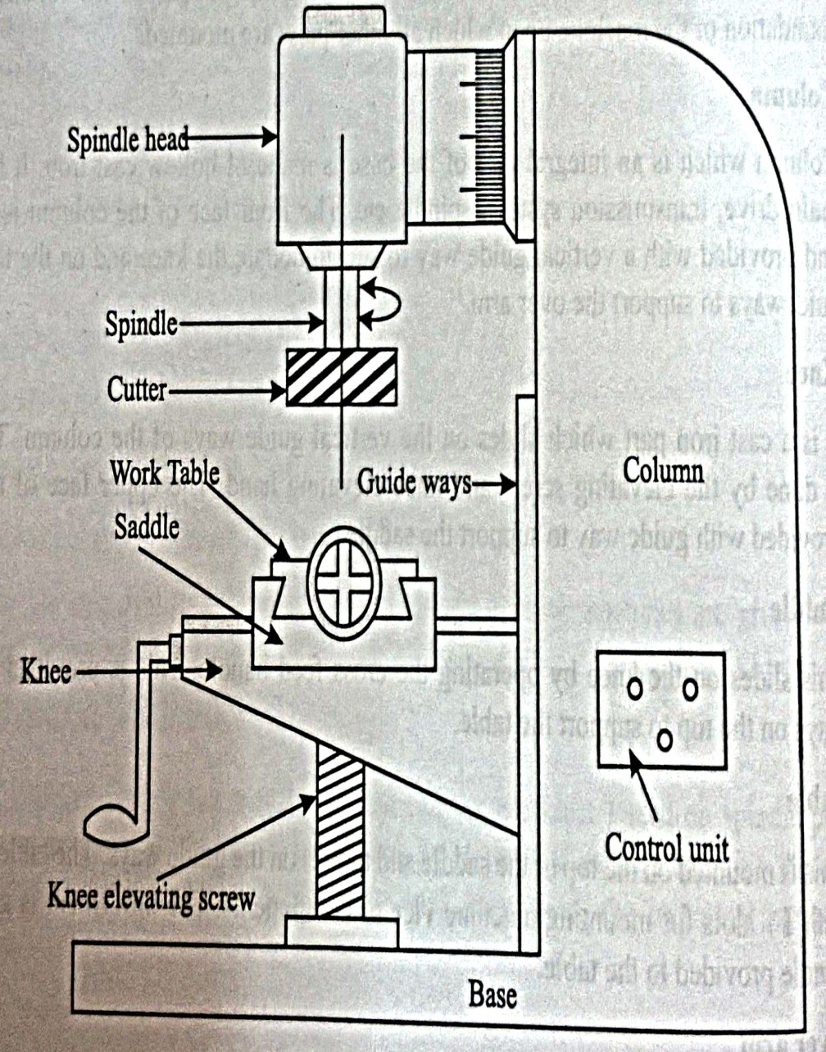
VERTICAL MILLING MACHINE
MAJOR PARTS :
BASE
COLUMN
SPINDLE
SPINDLE HEAD
KNEE
SADDLE
WORKTABLE
FIG. VERTICAL MILLING MACHINE

Slide 10
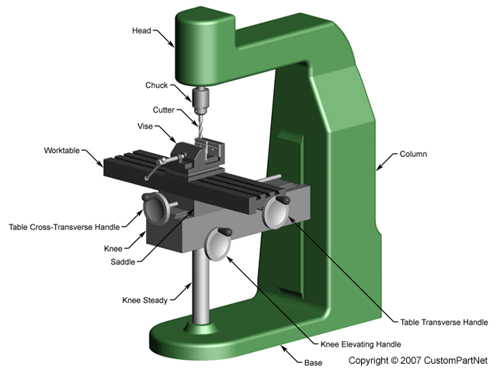

Slide 11
DIFFERENCES BETWEEN HORIZONTAL & VERTICAL MILLING MACHINES
SL. NO. | HORIZONTAL MILLING MACHINE | VERTICAL MILLING MACHINE
01 | Spindle is horizontal & parallel to the worktable. | Spindle is vertical & perpendicular to the worktable.
02 | Cutter cannot be moved up & down. | Cutter can be moved up & down.
03 | Cutter is mounted on the arbor. | Cutter is directly mounted on the spindle.
04 | Spindle cannot be tilted. | Spindle can be tilted for angular cutting.
05 | Operations such as plain milling, gear cutting, form milling, straddle milling, gang milling etc., can be performed. | Operations such as slot milling, T-slot milling, angular milling, flat milling etc., can be performed and also drilling, boring and reaming can be carried out.

Slide 12
MILLING OPERATIONS
Plain or slab milling
Face milling
End milling
Slot milling
Angular milling
Form milling
Straddle milling
Gang milling
Slitting or saw milling
Gear cutting

Slide 13
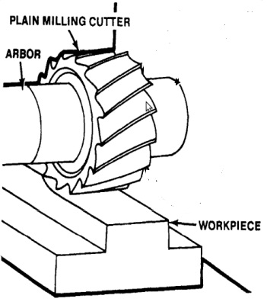
PLAIN/SURFACE/ SLAB MILLING
Plain Milling:
Process to get the flat surface on the work piece in which the cutter axis and work piece axis are parallel.
Cutter: Plain/ Slab milling cutter.
Machine: Horizontal Milling m/c.
FIG. PLAIN MILLING

Slide 14
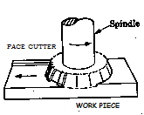
FACE MILLING
Face Milling:
Operation carried out for producing a flat surface, which is perpendicular to the axis of rotating cutter.
Cutter: Face milling cutter.
Machine: Vertical Milling Machine
FIG. FACE MILLING

Slide 15
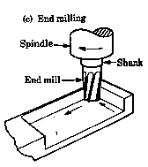
END MILLING
End Milling:
Operation performed for producing flat surfaces, slots, grooves or finishing the edges of the work piece.
Cutter: End milling cutter.
Machine: Vertical Milling Machine
FIG. END MILLING

Slide 16
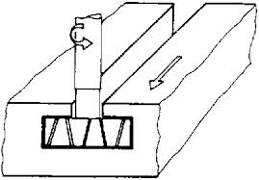
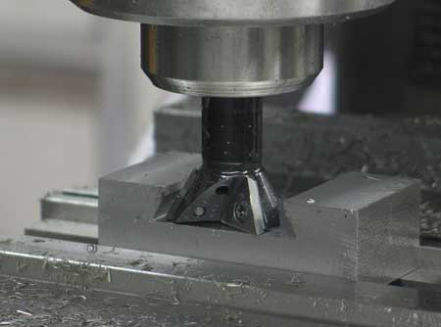
SLOT MILLING
SLOT Milling:
Operation of producing slots like T-slots, plain slots, dovetail slots etc.,
Cutter: End milling cutter, T-slot cutter, dovetail cutter or side milling cutter
Machine: Vertical Milling Machine
FIG. T-SLOT MILLING
FIG. DOVE TAIL SLOT MILLING

Slide 17
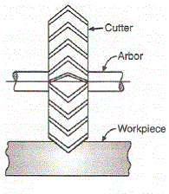
ANGULAR MILLING
Angular Milling:
Operation of producing all types of angular cuts like V-notches and grooves, serrations and angular surfaces.
Cutter: Double angle cutter.
Machine: Horizontal Milling Machine
FIG. ANGULAR MILLING

Slide 18
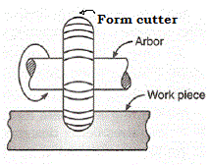
FORM MILLING
End Milling:
Operation of producing all types of angular cuts like V-notches and grooves, serrations and angular surfaces.
Cutter: Double angle cutter.
Machine: Horizontal Milling Machine
FIG. FORM MILLING

Slide 19
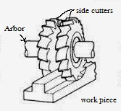
STRADDLE MILLING
Straddle Milling:
Operation of machining two parallel surfaces simultaneously on a work piece.
Cutter: 2 or more side & face milling cutters
Machine: Horizontal Milling Machine
FIG. STRADDLE MILLING

Slide 20
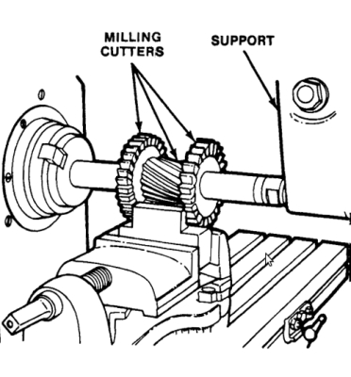
GANG MILLING
Gang Milling:
Process to get different profiles on the work piece simultaneously with two or more cutters at one stretch.
Cutter: Different cutters as required.
Machine: Horizontal Milling Machine
FIG. GANG MILLING

Slide 21
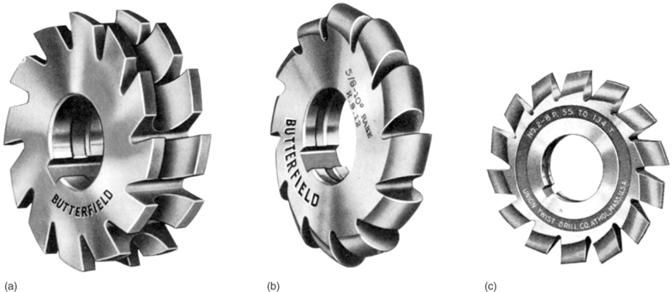
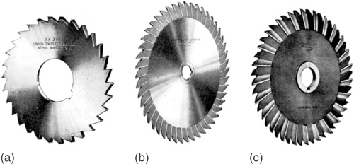

Slide 22
SPECIFICATIONS OF MILLING MACHINE
Size of the work table: expressed in length x width Eg: 1500 x 30mm.
Longitudinal movement: Total movement of table in mm(X-direction). Eg:800mm
Transverse movement: Total movement of saddle along with table in mm(Y-direction). Eg:200mm
Vertical movement: Total movement of table, saddle & knee in mm mm(Z-direction). Eg:380mm
Range of the speed: Speed variation in the gear box in RPM. Eg: 45 to 200 rpm.
Power capacity of the motor in HP. Eg: 2 HP

